Slide 1
Virtual Future Heroes Nursing Associate
Hello and welcome the session will begin shortly.
Please mute your mics and switch off your cameras.
If you need technical assistance please use the chat box and we will be happy to help.

Slide 2
House Keeping
Please mute your microphone and turn off your cameras. This will help us manage background noise during the presentations.
Please do not take any recordings or screen shots of the screen during the session
If you need any technical help during the event please message us using the chat box.
If you would like to ask a question please use the chat box.
The session will be not be recorded live but we will be uploading the presentations to the Extra Heroes webpage after this session.
Please bear with us if there are technical issues we will resolve them as quickly as possible. You may find that some of the videos we play may buffer, we will share the links after the event for anyone who had any issues watching them.
Social media – please tag us in @hwe_academy and #Future Heroes
Please join in with the quizzes and activities
Your feedback is important to use please feel free to email us – academy.hwe@nhs.net

Slide 3
Nursing Associates: ‘earn while you learn’
Discover training and employment through an apprenticeship

Slide 4
What is a Nursing Associate?
If you decide to study as a student nursing associate, you’ll gain skills and knowledge as well as practical experience in physical and mental health in adult and children’s nursing
These clinical skills could involve:
Carrying out and clinical observations, e.g. pulse, blood pressure readings;
Giving injections, taking blood, performing tests, e.g. heart tracing (ECG)
Qualified nursing associates have gone on to become specialists in the following areas:
GP practices giving childhood and holiday vaccinations;
Infection control;
Kidney dialysis;
Health and wellbeing;
Family and carer liaison.

Slide 5
Why be a Student Nursing Associate?
Earn while you learn!
No student debt
Gain apprenticeship and foundation degree qualifications
Develop your academic skills
Obtain practical experience through supported placements
Build great friendships!
Take your career to new heights
Be the best person you can be!

Slide 6
Let’s hear from our ambassadors
Tonie Magiya
Zoe Hall
Anna-Liza Delgaudo
Joanna Bowyer
Visit: Health and Care Academy Website

Slide 7
Why study as a Student Nursing Associate?

Slide 8
Entry requirements
To begin your training as a nursing associate you’ll need:
GCSEs grade 9 to 4 (A to C) in maths and English, or Functional Skills Level 2 in maths and English as a minimum
Demonstrate your ability to study to level 5 foundation degree level and commit to completing the Nursing Associate Apprenticeship programme
Some student places are available through direct application to universities; applicants accepted this way will need to fund their own training

Slide 9
Apprenticeship levels and eligibility
Levels of apprenticeship
Apprenticeships have equivalent educational levels.
Some apprenticeships may also give you an additional qualification, such as a diploma.
Eligible?
 | Level | Equivalent educational level
Intermediate | 2 | GCSE
Advanced | 3 | A level
Higher | 4,5,6 and 7 | Foundation degree and above
Degree | 6 and 7 | Bachelor’s or master’s degree
Check with training provider that any previous qualifications are suitable.
Achieved the pre-requisite qualifications (e.g. Maths and English level 2)

Slide 10
Academic study
You will undertake academic learning one day a week and practical learning for the rest of the week
You'll be employed in a specific healthcare setting such as in a hospital, community or mental health setting, care home or hospice
You will also gain experience in other health and care settings which is the practice placement part of the course (Six 6-week placements)
You will need to travel to placements and work different shift patterns.

Slide 11
Gain experiences and skills

Slide 12
Nursing Associates ‘fill the gap’

Slide 13
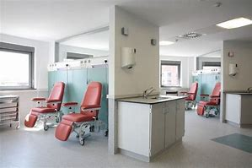
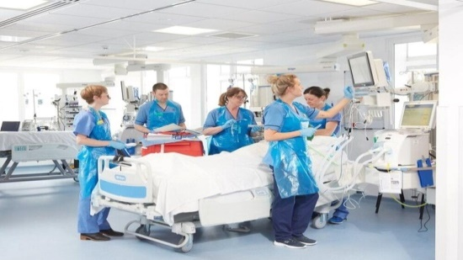
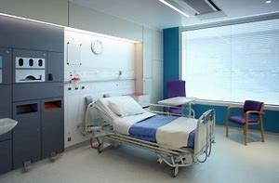
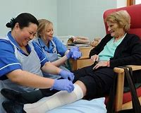
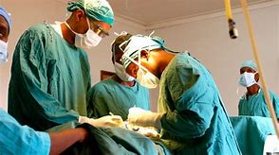

Slide 14
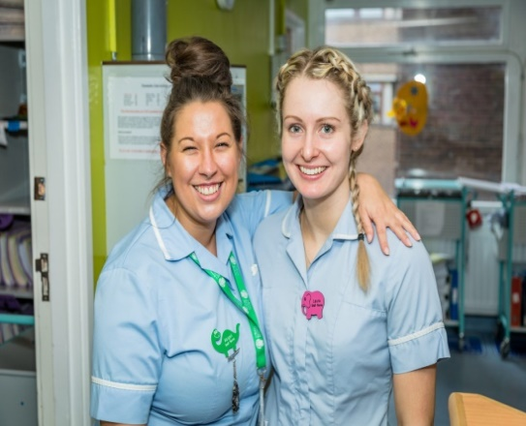
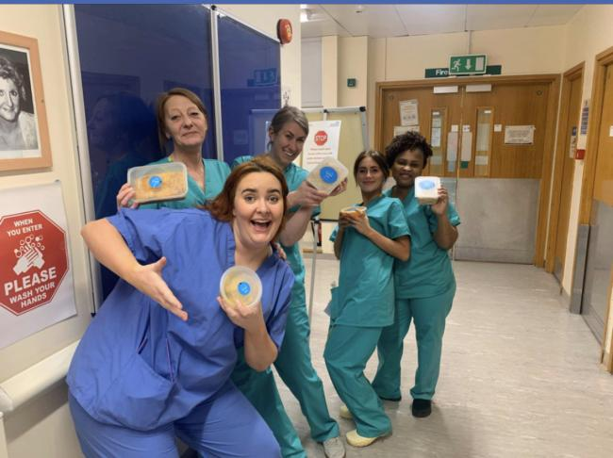

Slide 15
Please put your questions in the chat box and we will come back to as many as possible after the next presentation

